Slide 1
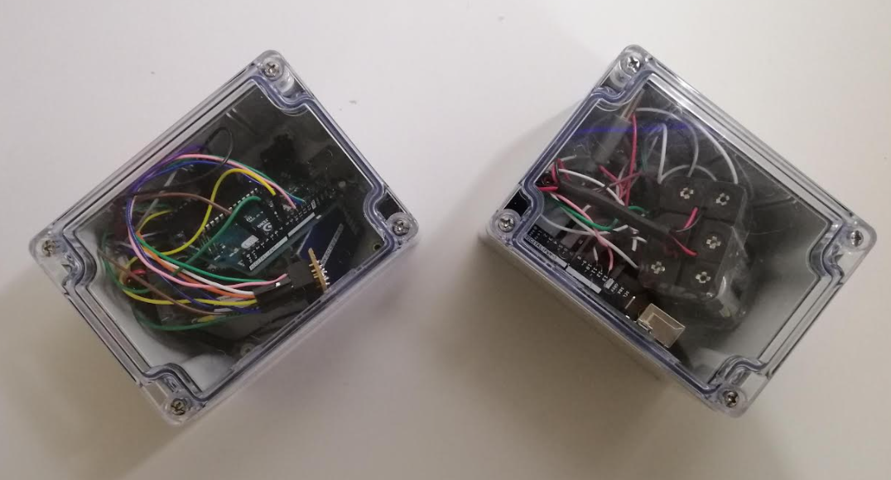
Group 18’s Presentation Underwater Modem
Ali Alshumaimri, Toby Giri, Hau Shian, Jonathan haydon, Jamie reynolds
Client: Alvin Valera

Slide 2





Meet the team
Ali Ibrahim
Toby Giri
Hau Shian
Jon Haydon
Jamie Reynolds

Slide 3
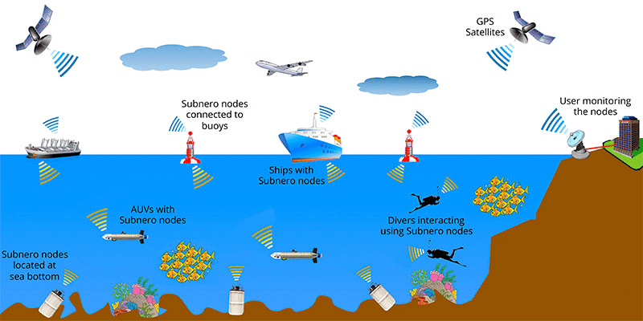
Introduction
Underwater Communication
Ali Ibrahim
Notes:
Mention reasoning for underwater communication (Motivation).
Liquid robots < Search

Slide 4


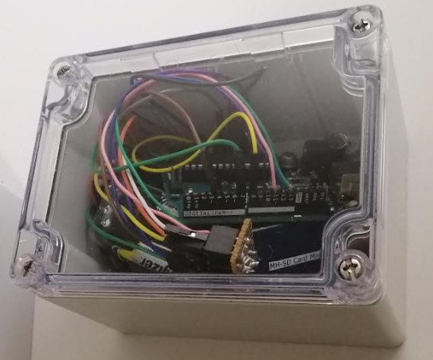


Motivation
Ali Ibrahim
Notes:
Estuary project

Slide 5


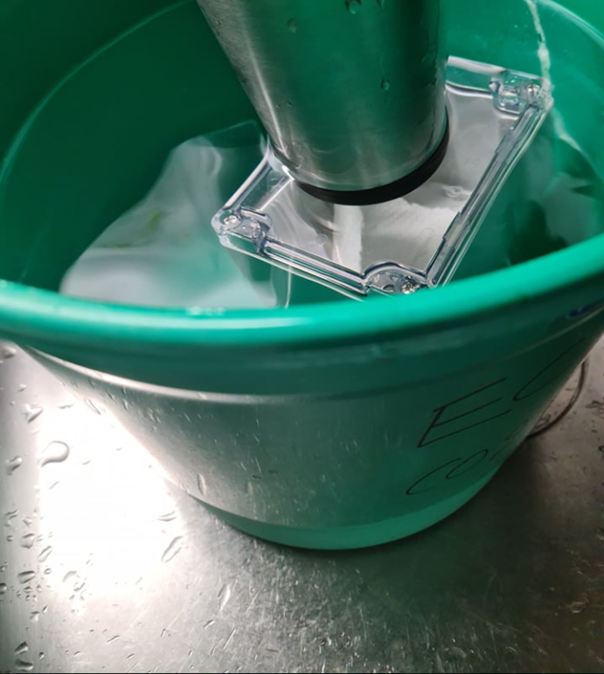

Requirements of Project
Communicate data wirelessly underwater
10m+ range communication
Long battery life
Low power consumption
10m range
Ali Ibrahim

Slide 6
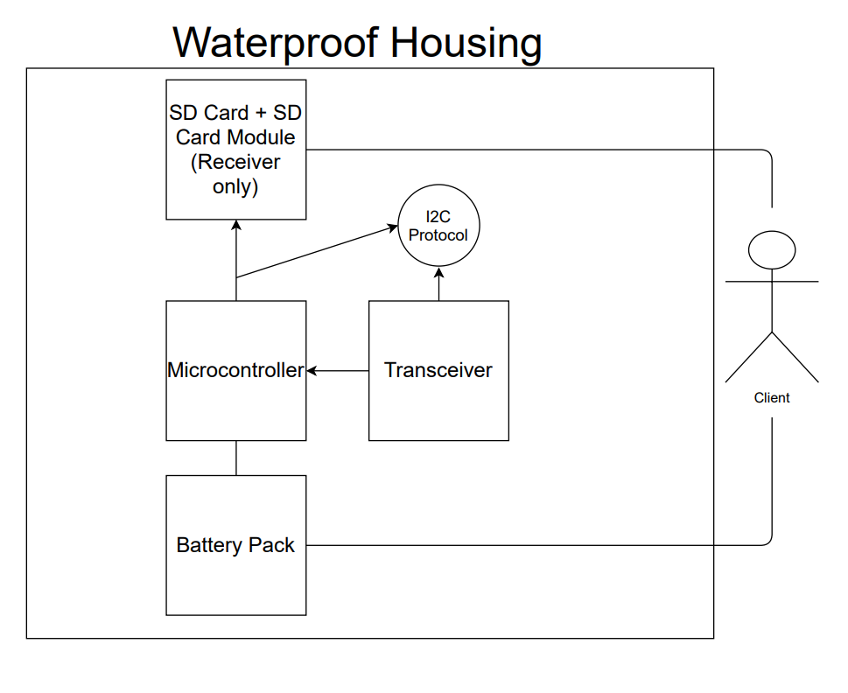
Architecture Diagram
Toby Giri

Slide 7
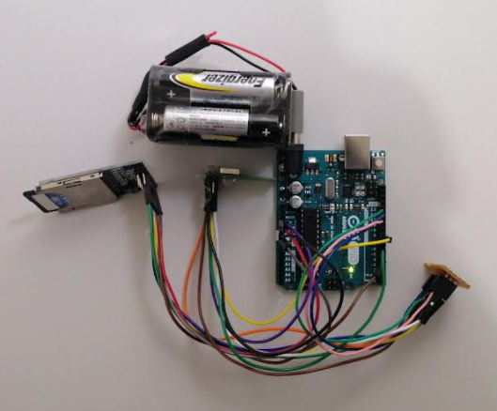
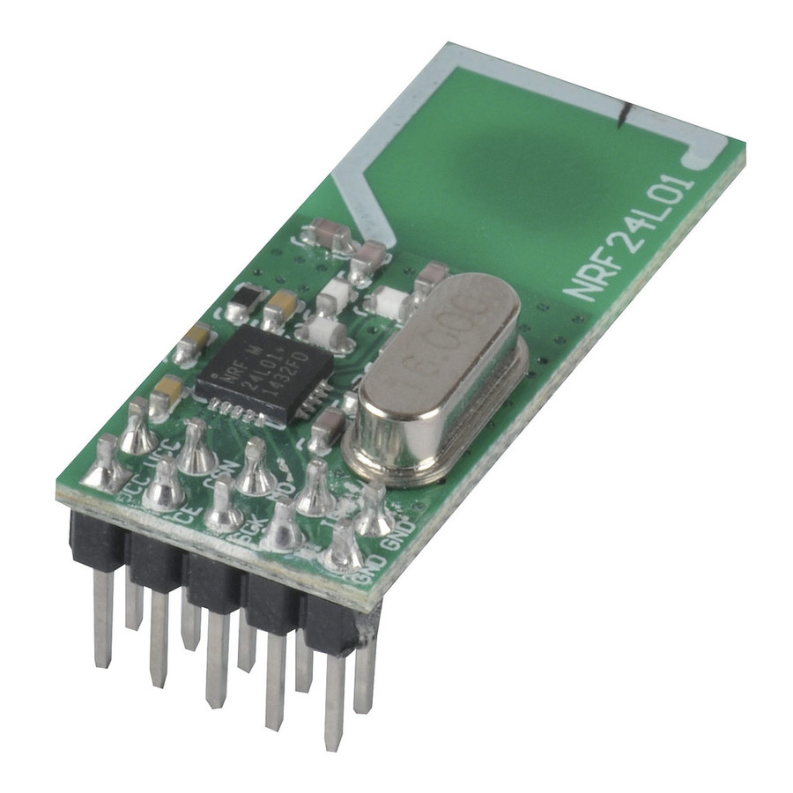
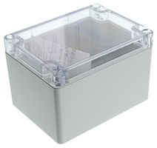

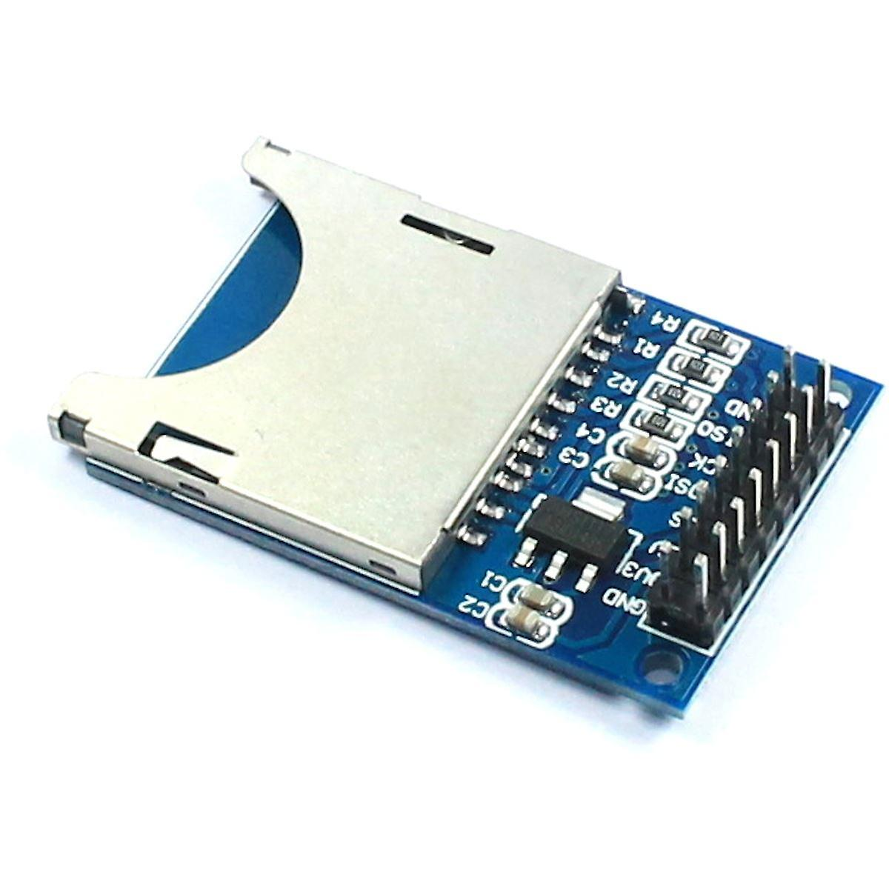
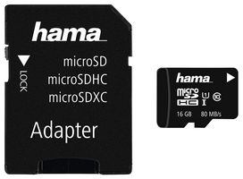
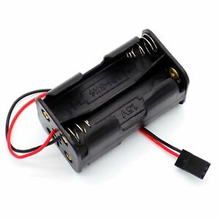
Hardware
1) Arduino Uno x2
2) NRF24L01 x2
3) SD Card x1
4) Module x1
5) Battery pack
6) Waterproof casing x2
2
6
Components Required
4
3
5
1
Toby Giri
Notes:
- Arch Diagram

Slide 8
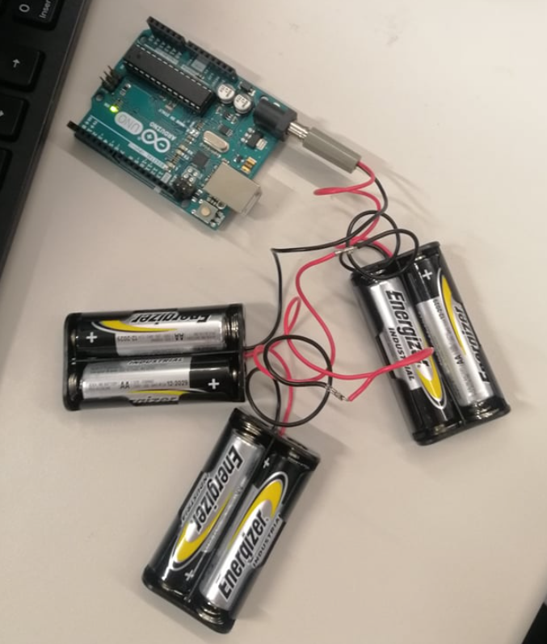
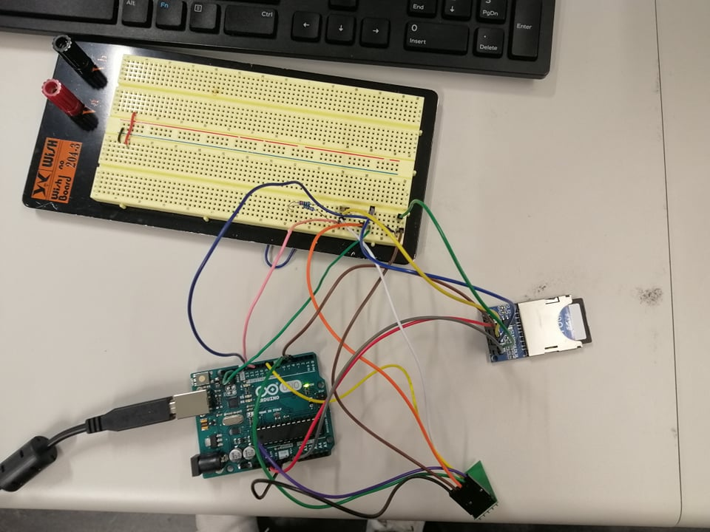
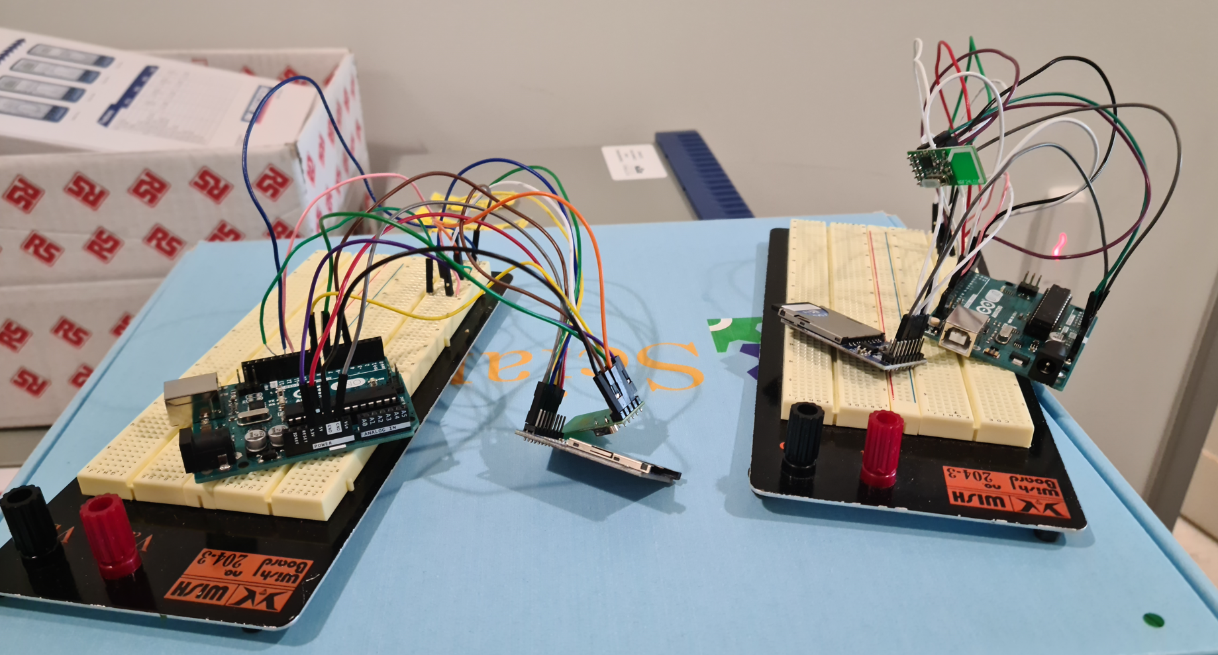
Photos of Hardware Progress
Battery Pack connected to Arduino Uno
Circuitry prototype
Prototype of transceiver and receiver
Toby Giri

Slide 9

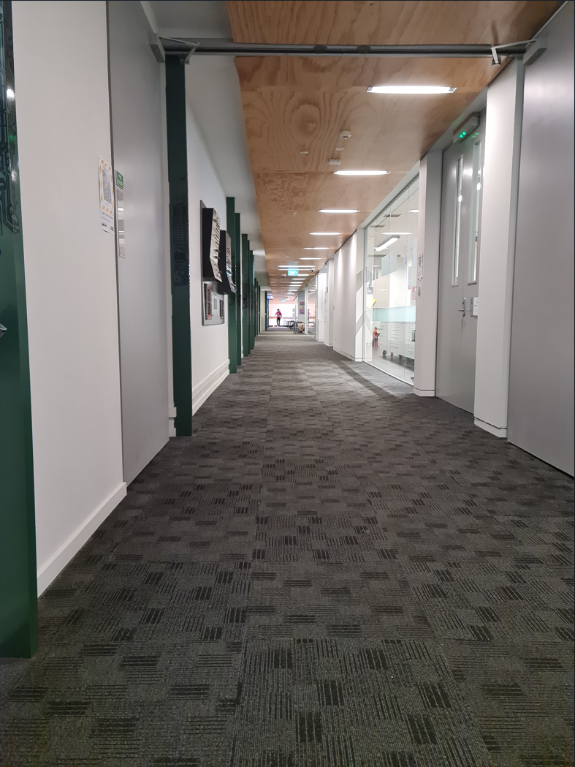


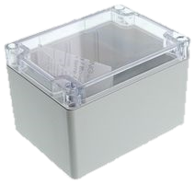

Testing
1) Air to Air Communication
2) Water to Air Communication
3) Water to Water Communication
Stable communication (ECS Hallway length)
Air - Air
Water - Air
Water - Water
Hau Shian
Notes:
Easiest to hardest order
Why we did it in this order?
Add diagram of each testing method

Slide 10
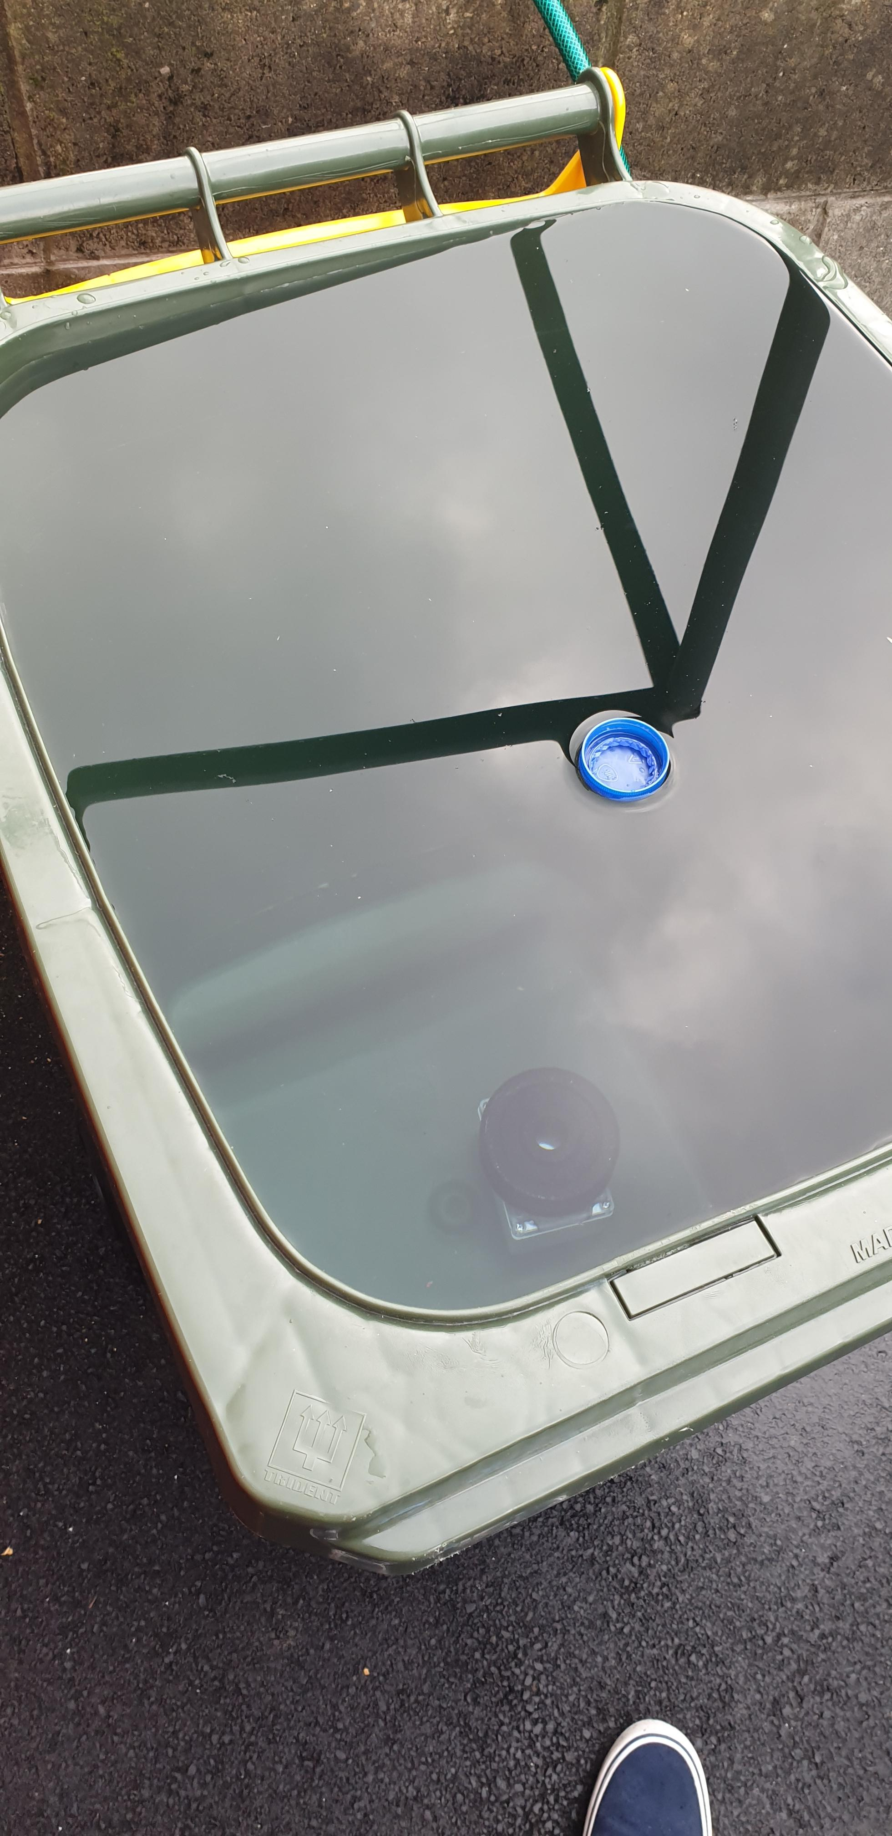
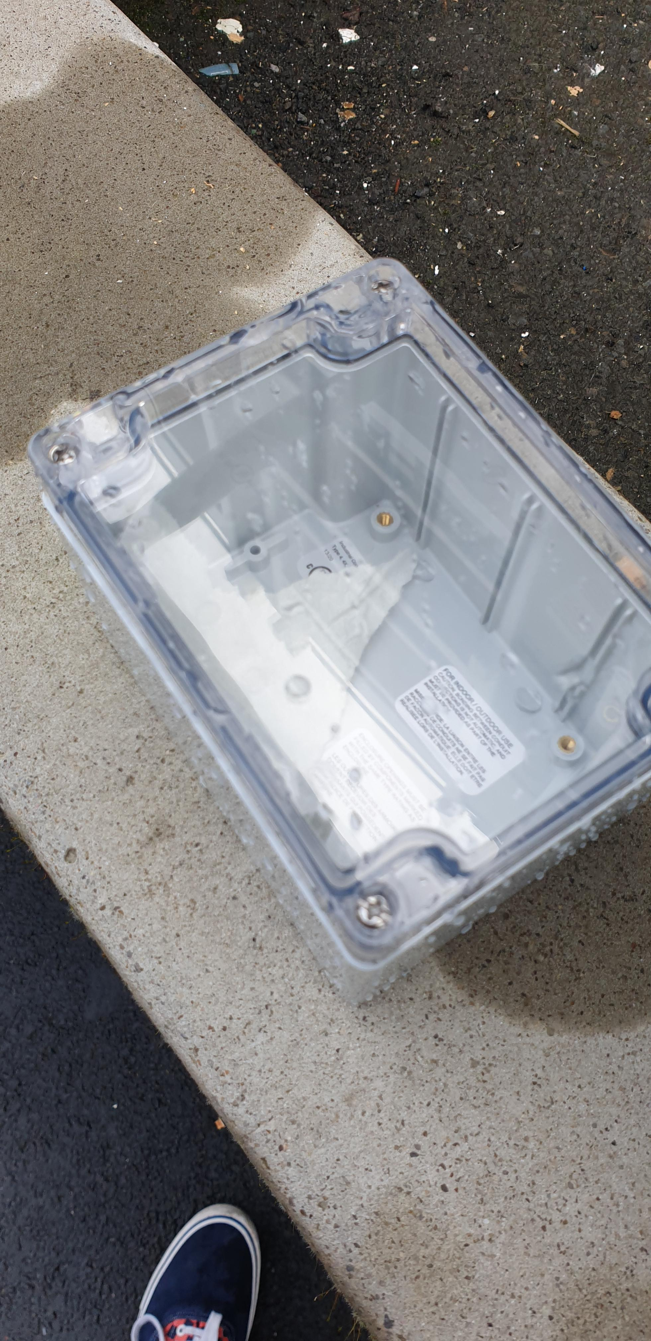
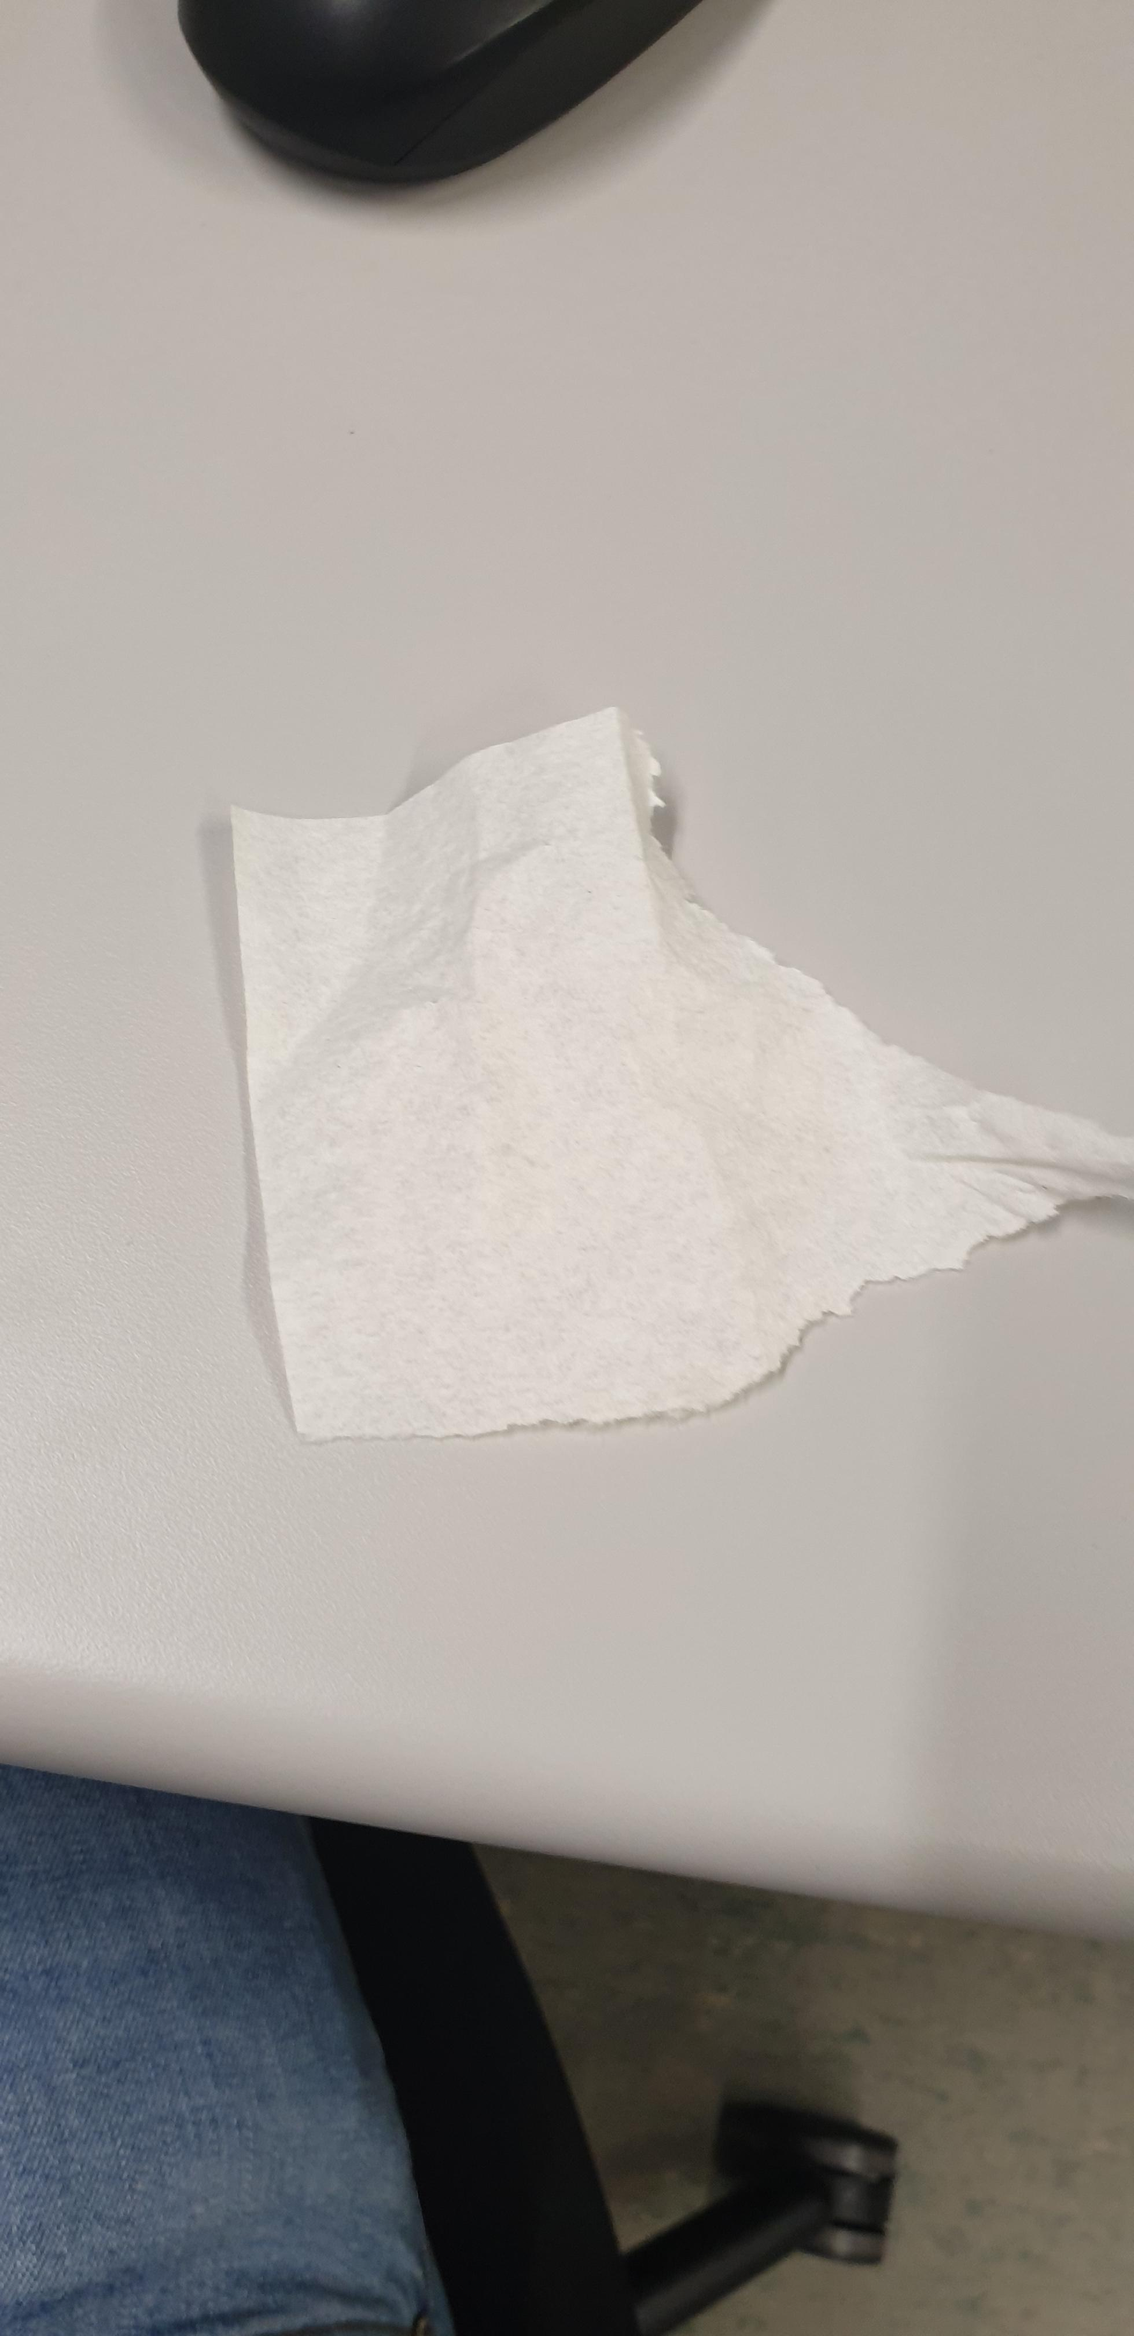
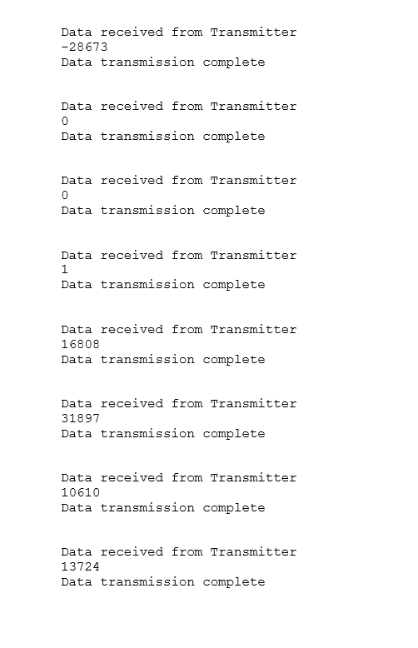
Testing Methods
Waterproof testing
Waterproof confirmed
Moisture Indicator
Stored Received Data
Hau Shian

Slide 11




Risks
Dependencies not being satisfied
Coronavirus
Loss of project member
Hardware failures
Jonathan Haydon
Notes:
More about hardware failures, less coronavirus and loss of project members
More technical details

Slide 12
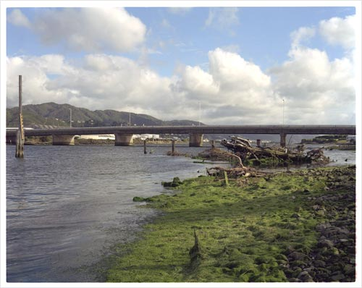




Future Of Project
Aptamer connection
Battery upgrade
Code adjustments
Final Deployment
Jamie Reynolds

Slide 13
Lessons Learned from Project
Management Lessons
Safety Nets
Event precautions
Hardware lessons
Handling of hardware
Spare parts
Jamie Reynolds

Slide 14
THANK YOU FOR LISTENING

